Slide 1


B. Tech(Computer Science Engineering)
LOVELY PROFESSIONAL UNIVERSITY
PHAGWARA,PUNJAB
CSE343 - Training in Programming
Basic Of Data Structures and Algorithm using CPP
From June 10,2025 to July 20,2025
Presented By
Priya Kumari

Slide 2




Training Certificate

Slide 3

Why DSA is Important
Data Structures and Algorithms (DSA) are important because they provide the essential methods and frameworks to efficiently organize, store, and process large and complex data, which is critical in today’s data-driven world. By using appropriate data structures like arrays, trees, graphs, and hash tables, and designing efficient algorithms, we optimize performance and resource usage, making software faster and more scalable. Without DSA, managing and utilizing the massive volume of data generated daily would be impractical and inefficient.

Slide 4




Project: To-Do List Manager
Objectives
Scope
•Design a simple web-based To-Do List Manager.
•Demonstrate CRUD operations using arrays and JavaScript.
•Save tasks so they don’t disappear after refresh.
•Show how DSA ideas work in real projects.
•Web-based app, accessible on modern browsers.
•Lightweight, user-friendly interface
•Saves tasks using localStorage.
•Deployed globally via Netlify.

Slide 5
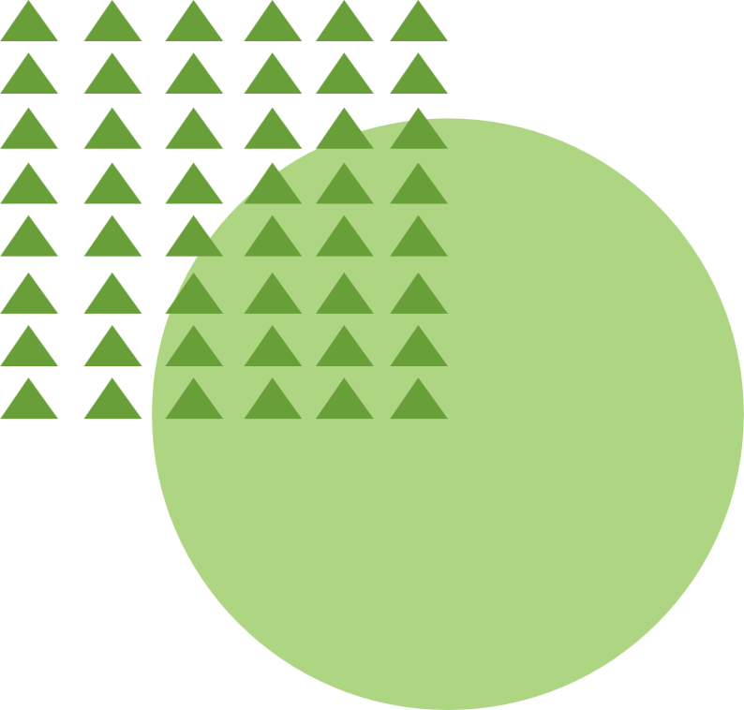









Work Done: To Do List Manager
Position:
This project aimed to build a To-Do application leveraging HTML, CSS, and JavaScript to create a functional task manager that allows adding, deleting, marking as completed, and saving tasks
Add Task
Delete Task
Remove tasks from the list.
Add new tasks to the list
Mark Complete
Save Data
Mark tasks as completed
Persistent storage using localStorage

Slide 6

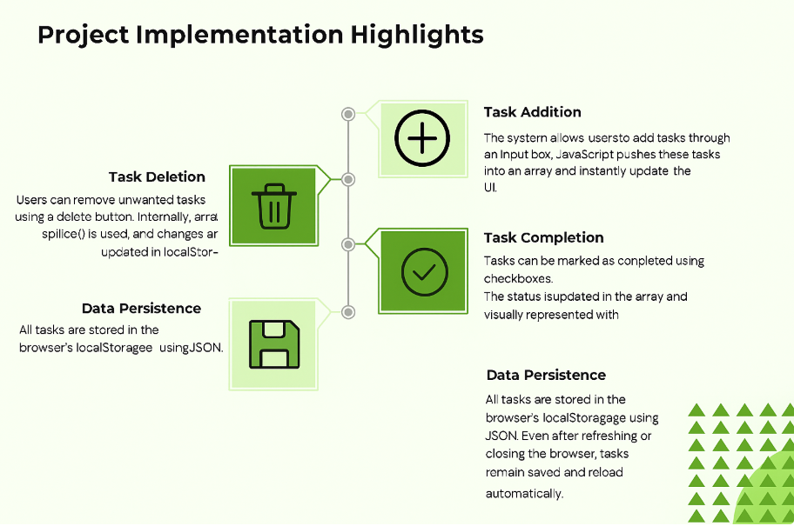
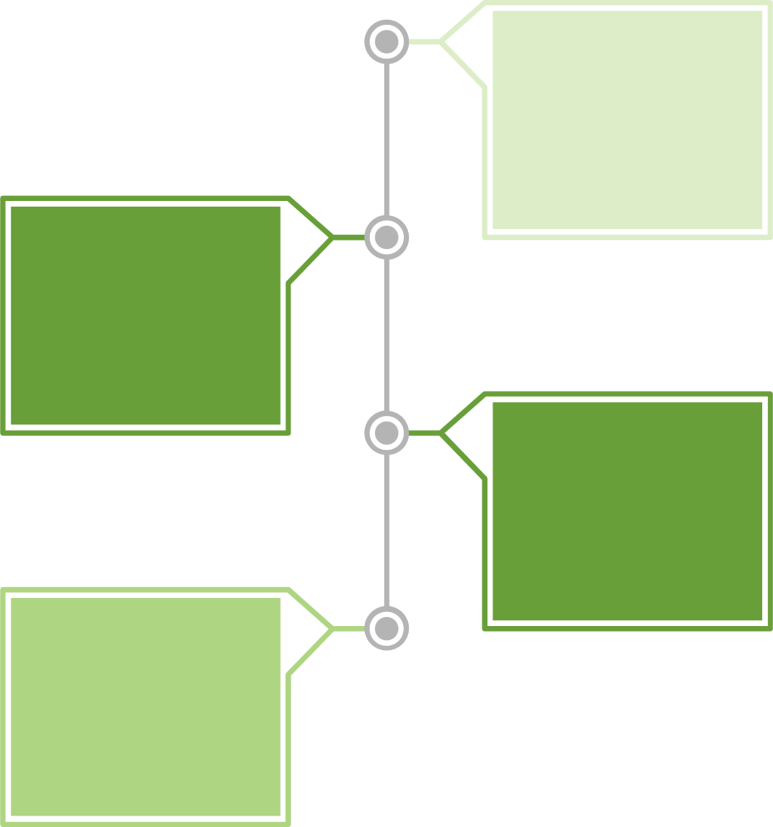




Project Implementation Highlights
User Profile Management
The system initializes and manages user profiles, storing data in "user_profile.txt". It handles new users by creating files and ensures graceful error management for file operations.
Motivational Quotes
The QuoteProvider class delivers random motivational quotes from a vector, encouraging positivity after mood check-ins.
Mood Logging
Users select moods (Happy, Neutral, Sad, Anxious, Excited), which are recorded with timestamps in "mood_log.txt". This data helps detect mood patterns.
Interactive Exercises
A guided breathing exercise uses C++ threading to provide timed instructions, promoting mindfulness and reducing anxiety.

Slide 7






Event Handling Issues
Ensuring that buttons and dynamically generated elements had correct event listeners.. Add/Delete functions sometimes failed to trigger properly.
Array Indexing Problems
Off-by-one errors occurred when deleting tasks . Some tasks were duplicated or not removed correctly.
Persistence Errors
Challenges Faced
Issues in converting arrays to JSON and parsing back . Data was not always saved or loaded properly.

Slide 8
Project Introduction
To Do List Manager
The To-Do List Manager is a simple web-based application built using HTML, CSS, and JavaScript. It helps users organize daily tasks, mark them as complete, and delete them when no longer needed. The application ensures persistence using local Storage, so tasks remain saved even after closing or refreshing the page.
To-Do List Manager provides:
Add New Task(insert tasks into the list)
Mark as Completed/Uncompleted(toggle status with a click)
Data Persistence(tasks remain available across sessions via localStorage)
Delete Task(remove unwanted tasks)
User-Friendly Interface(lightweight and simple to use)

Slide 9
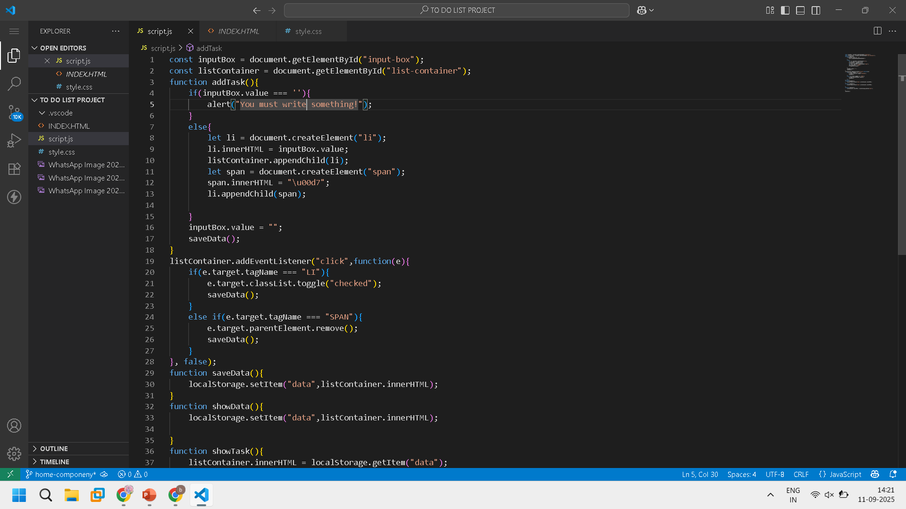
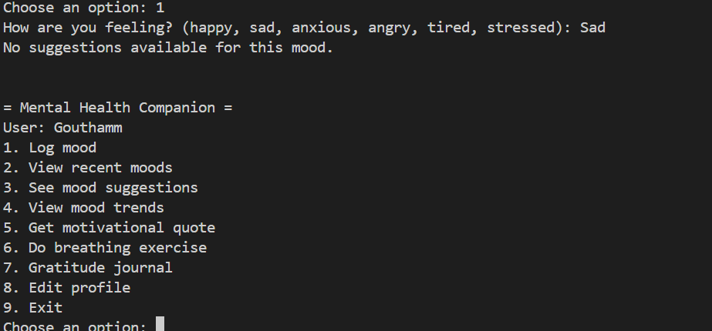
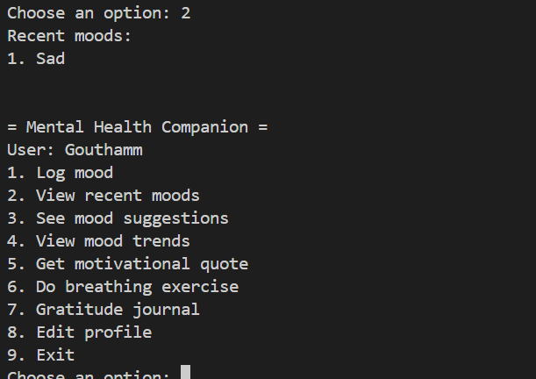
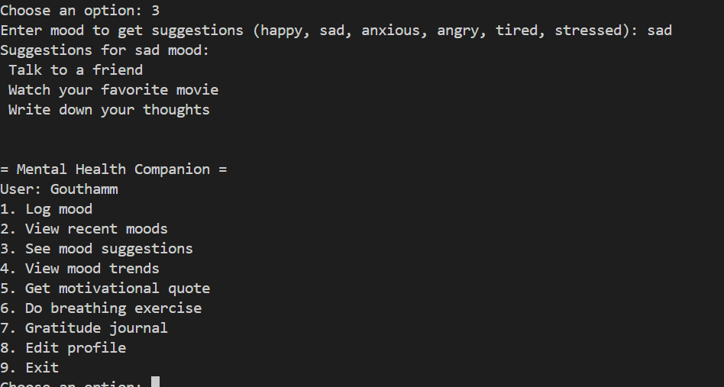
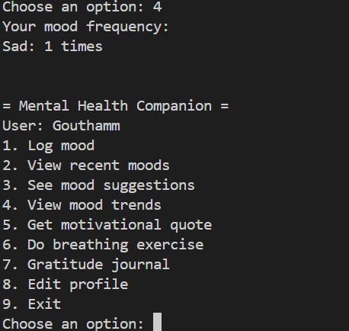
“The system logs the user’s mood and provides suggestions, but inputs are case-sensitive (e.g., ‘Sad’ vs ‘sad’).”
“The application displays the user’s recently logged moods for quick review.”
“Based on the entered mood, the system suggests simple activities to improve emotional well-being.”
“The system displays mood frequency statistics and offers a range of supportive tools to help track and enhance emotional health.”

Slide 10
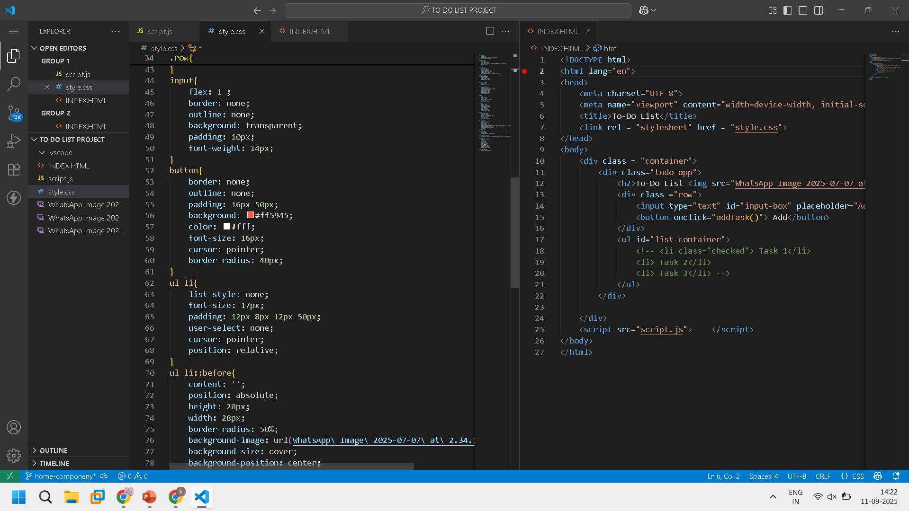
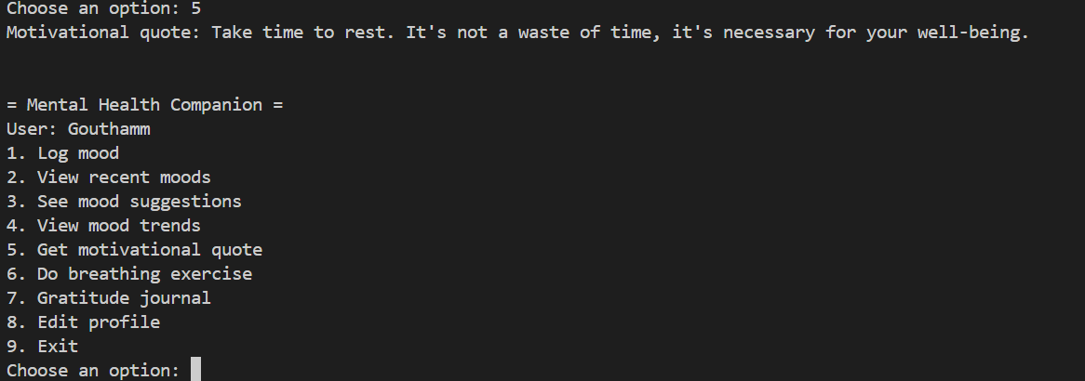
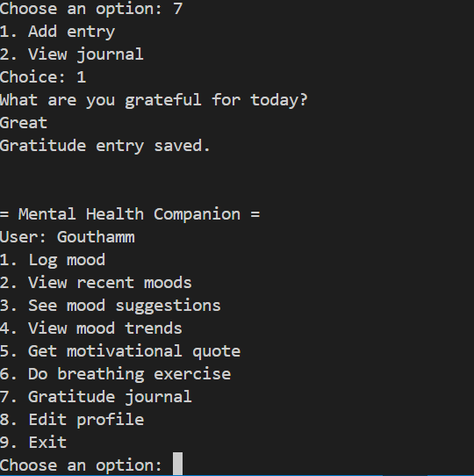
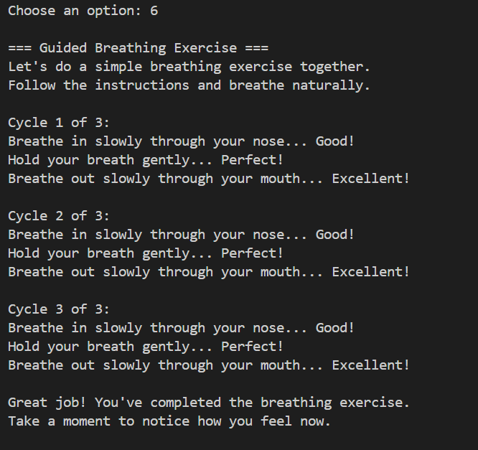
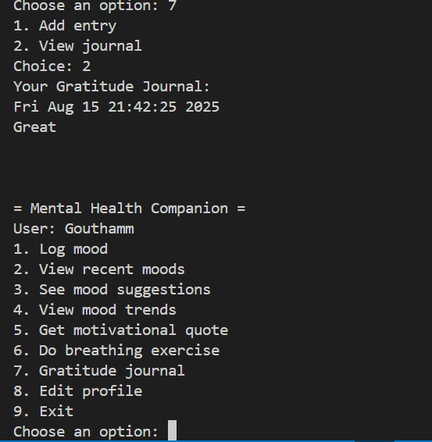
The system encourages positive reflection by allowing users to add gratitude entries and save what they are thankful for each day.
The system provides uplifting motivational quotes to encourage healthy self-care and emotional well-being
The system guides users through a calming breathing exercise to help relieve stress and promote relaxation.
The system lets users view their gratitude journal entries, fostering ongoing positivity and reflection on things they appreciate.

Slide 11
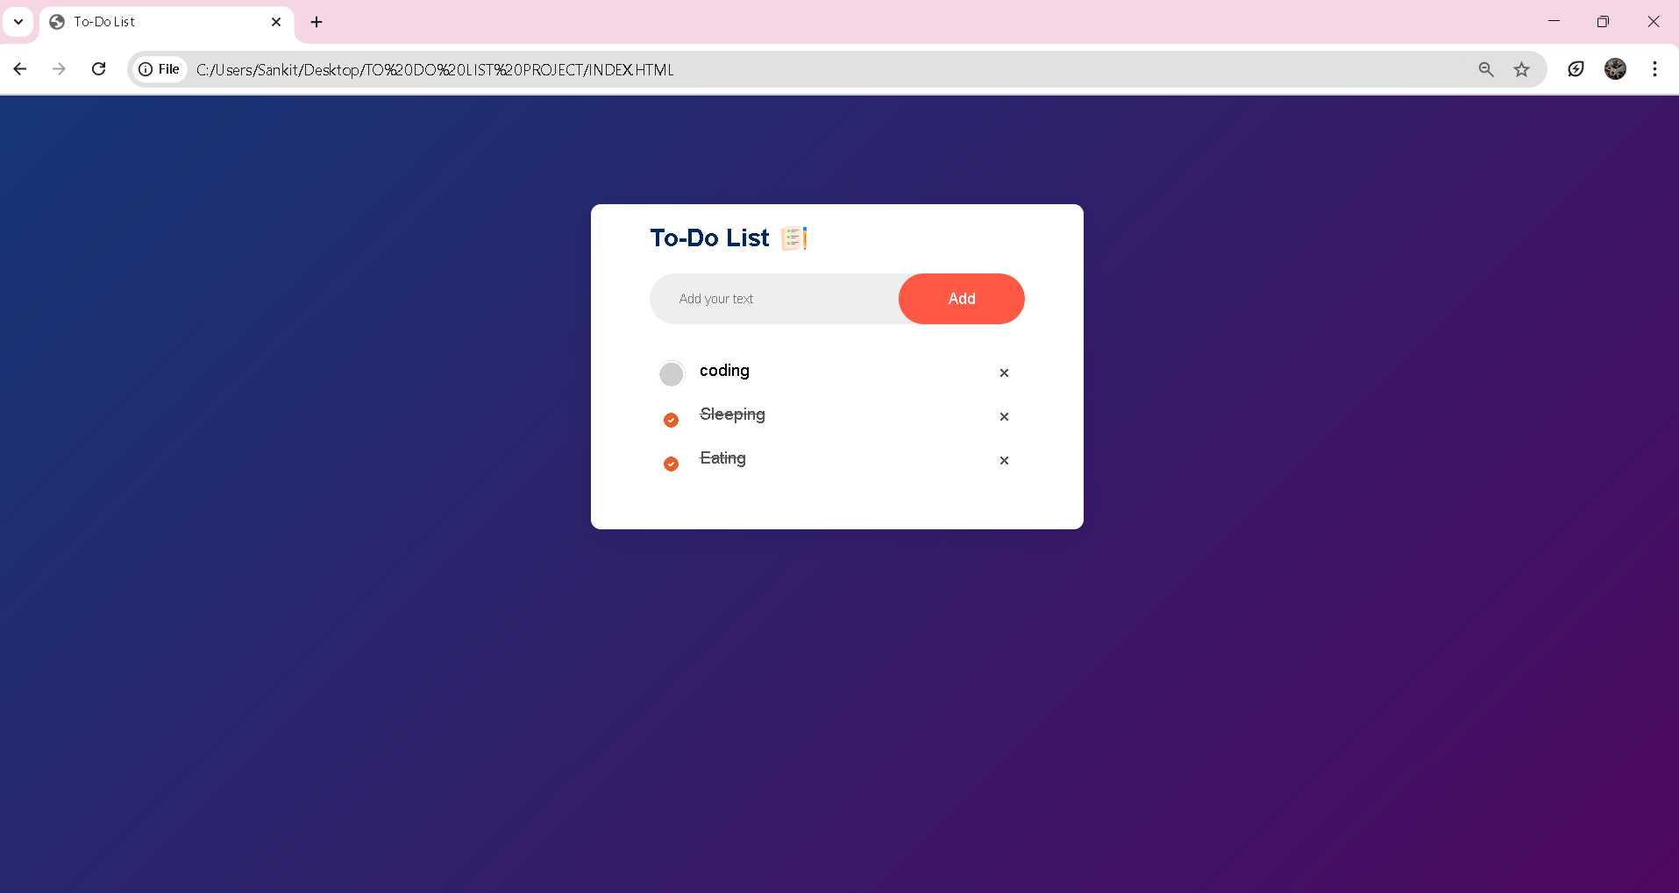
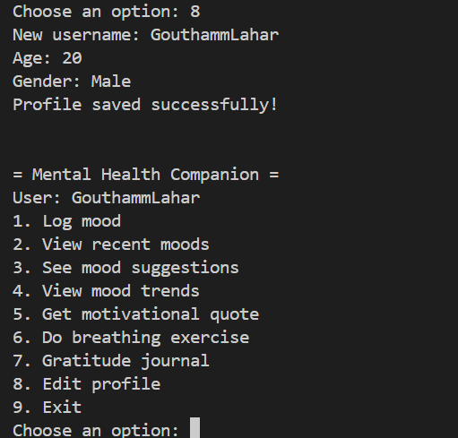


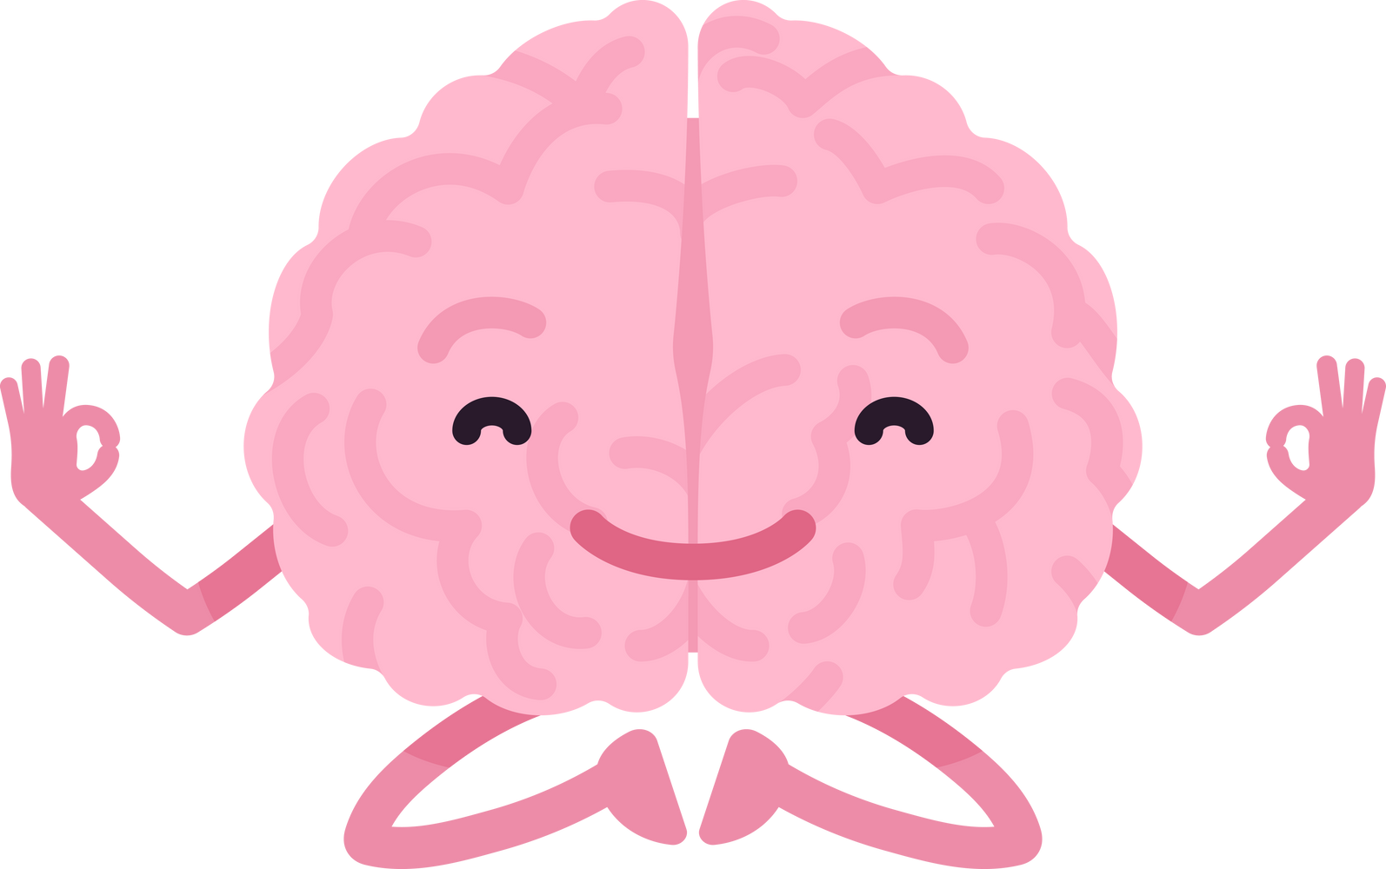
The Mental Health Companion offers a comprehensive, user-friendly suite to support emotional wellness—helping users track moods, receive personalized suggestions, practice mindfulness, reflect with gratitude, and access motivational guidance. Each feature is designed to encourage positive habits, self-awareness, and stress relief, empowering individuals to manage their well-being with practical tools in a supportive environment.
The system enables users to update their profile details, ensuring personalized support and accurate record keeping.
The system ends with a caring farewell message, encouraging users to look after their well-being.

Slide 12


Conclusion
The To-Do List Manager project helped me apply Data Structures and Algorithms in a real application. I used arrays to add, delete, and update tasks, and stored them with local Storage. This showed how theory can be turned into practical solutions. I also learned HTML, CSS, and JavaScript for building the interface and logic. During the project, I faced challenges like event handling, indexing, and UI design, which improved my problem-solving skills. The app is lightweight, user-friendly, and persistent, making it useful for daily task management. It proved that even simple apps are based on strong computer science concepts. This project gave me both technical knowledge and confidence for future development work.

Slide 13

Thank you!

